Slide 1
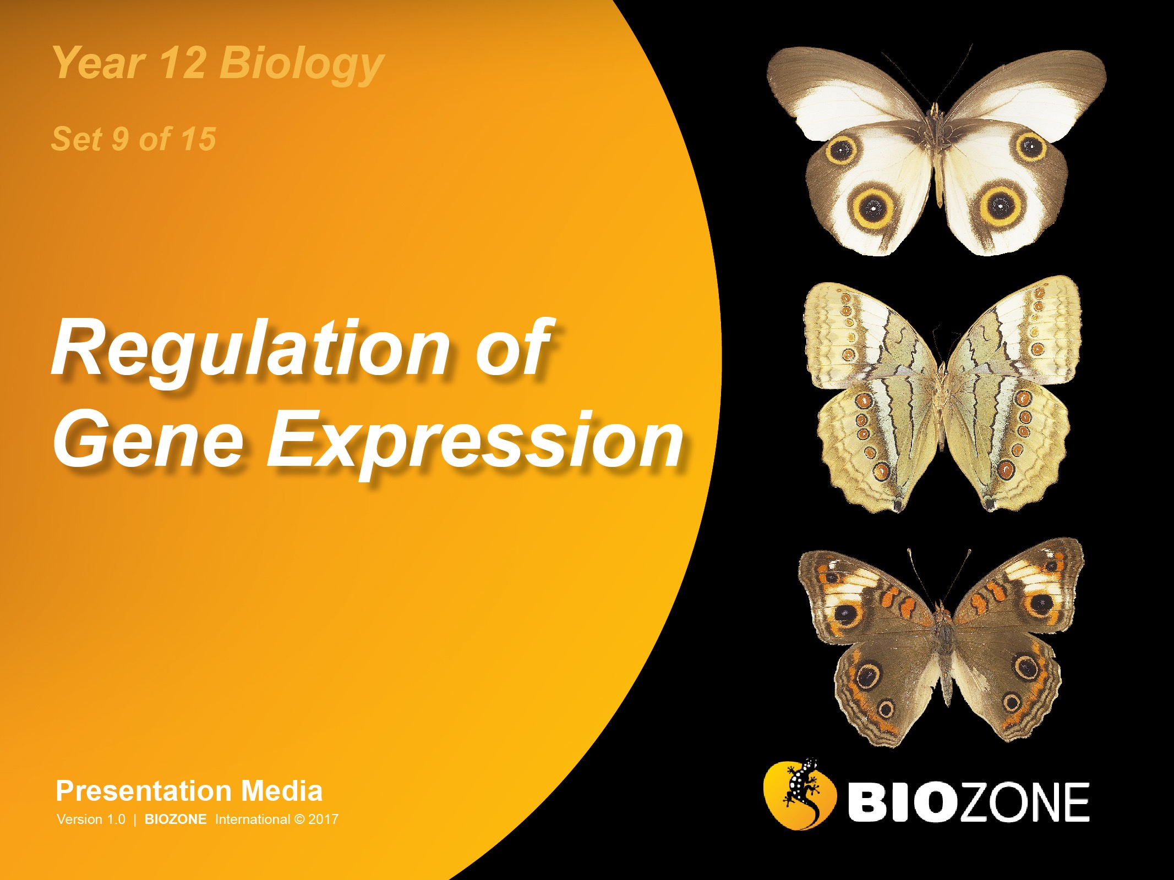

Slide 2
Gene Regulation
Cellular differentiation
Genes and development
Timing and development
Mutations
Gene structure and regulation
Cancer

Slide 3
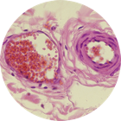
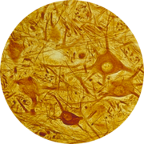
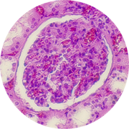
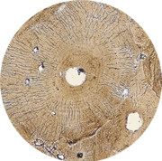
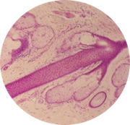
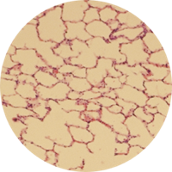
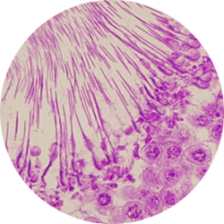

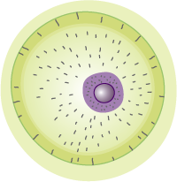
Differentiation of Human Cells
Blood vessels
Photo: EII
A zygote begins development by dividing into a few dozen identical embryonic stem cells.
Regulation of gene expression determines what cell type will develop from a embryonic stem cell.
The cells take different developmental pathways to become specialised cells.
Differentiation is the end result of this development.
Spinal tissue
Glands
Photo: EII
Kidney
Photo: EII
Bone
Photo: EII
Mesoderm
Ectoderm
Endoderm
Lung
Photo: EII
Germline
Gastrula: two layered embryo
Photo: EII
Zygote: fertilised egg
Sperm producing cells
Photo: EII

Slide 4
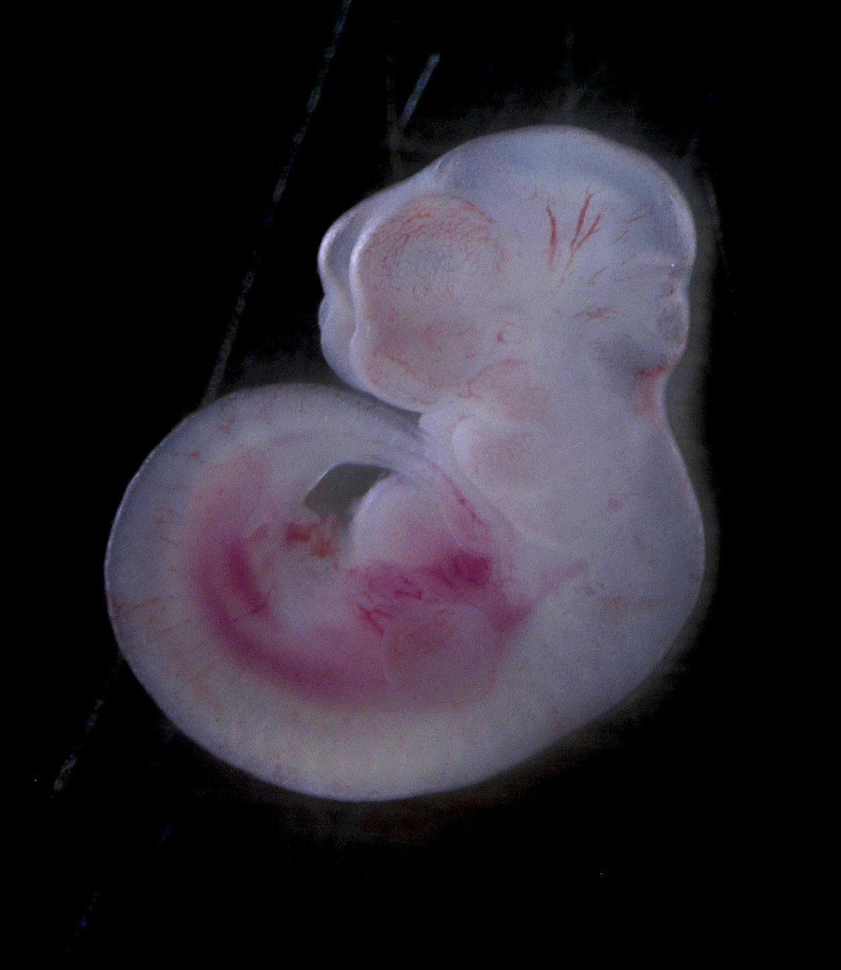
Development
Development is the process of progressive change through the lifetime of an organism.
It involves growth (increase in size) and cell division (to generate the multicellular body).
Cellular differentiation (the generation of specialised cells from more generalised ones) and morphogenesis (the creation of the shape and form of the body) are also part of development.
Selective cell proliferation combined with selective apoptosis sculpts the tissues and structures in all vertebrates.
In the mouse embryo, mesoderm forms between the toes giving the appearance of a webbed, paddle like structure (above right). As the embryo develops, this superfluous webbing is selectively destroyed by apoptosis so that each of the individual digits are visible (below right, arrowed).
Matthias Zepper

Slide 5
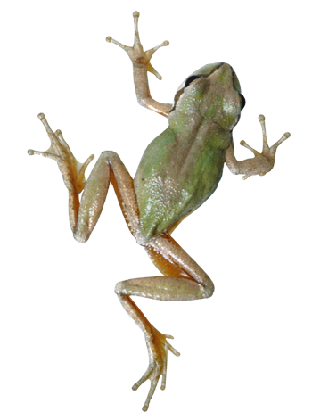
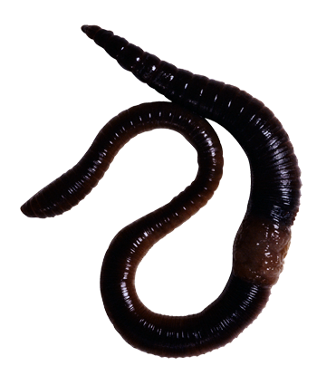
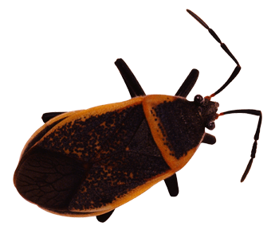
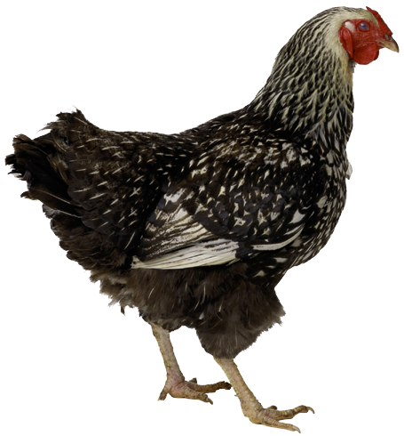
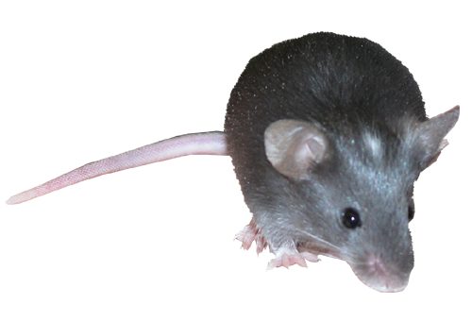
The Role of Genes in Development
Amphibians
Annelids
Genes called homeotic genes determine basic aspects of form such as where a pair of legs or wings will develop.
Homeotic genes were first discovered in Drosophila, but very similar sequences have been found in many organisms, including humans.
The similarity of homeotic gene sequences across phyla indicates that these genes governing the positioning of body parts arose early in the evolution of animals.
Insects
Mammals
Homeotic genes show similarity across many taxa
Birds

Slide 6
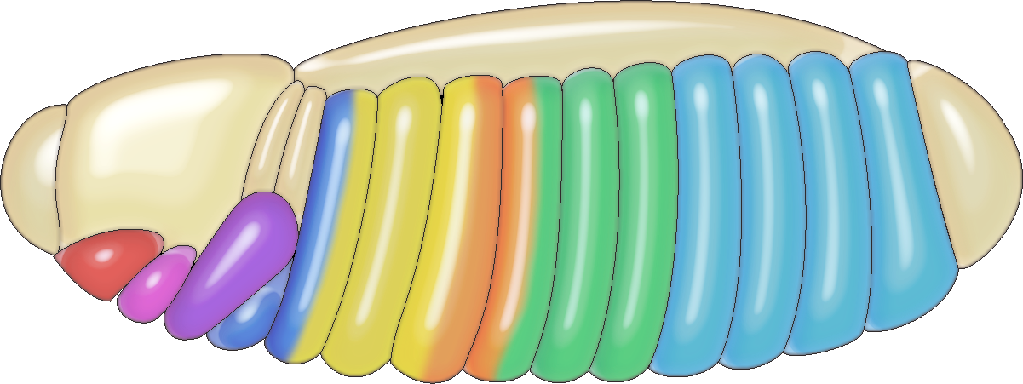
The Role of Homeotic Genes
In Drosophila, two homeotic gene clusters control where structures develop in the embryo:
Bithorax complex controls the differences between the abdominal and thoracic segments of the body.
Antennapedia complex controls the differences among thoracic and head segments.
The same genes (or homologous ones) are present in essentially all animals, including humans.
Both gene clusters are part of a single complex known as Hox, which controls the development of back and front parts of the body.
Drosophila embryo
Head
Thorax
Abdomen
Antennapedia complex
(anterior)
Bithorax complex
(posterior)
Homeotic genes act as master switches to determine the positioning of body parts. The order of the genes reflects the order of the body parts they control.

Slide 7
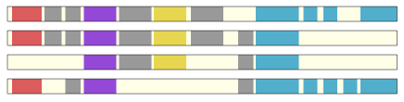
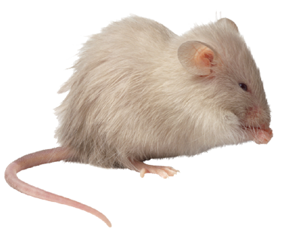
Changes in Hox Genes
Drosophila embryo
The Hox genes, and their ordered nature, are highly conserved in evolution.
Even very small changes (mutations) in the Hox genes can have a profound effect on morphology.
Such changes to the genes controlling development have almost certainly been important in the evolution of novel structures and body plans.
Huge diversity in morphology in organisms across many phyla could have arisen through small changes in the genes controlling development.
Antennapedia complex
Bithorax complex
The Hox genes are located on a single chromosome in Drosophila, and on four separate chromosomes in the mouse.
The colour-coding indicates where in the body the genes are expressed.
Mouse

Slide 8
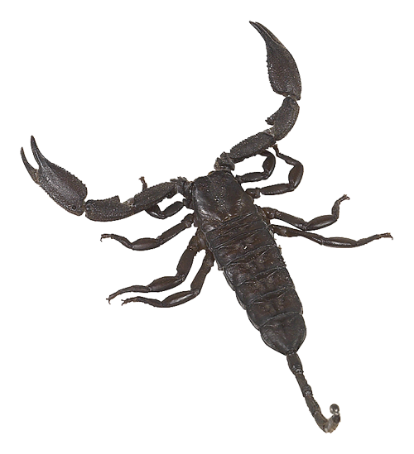
The Evolution of New Forms
Four principles underlie the role of developmental genes in the evolution of novel forms:
Evolution works with what it is already present: New structures are modifications of pre-existing ones.
Multifunctionality and redundancy: Functional redundancy in any part of a multifunctional structure allows for specialisation and division of labour through the development of two separate structures.
Example: The diversity of appendages in arthropods.
Modularity: Modular architecture in animals (arthropods, vertebrates) allows for the modification and specialisation of individual body parts. Genetic switches allow changes in one part of a structure, independent of other parts.
The diverse appendages of arthropods are all derivatives of a common ancestral design

Slide 9
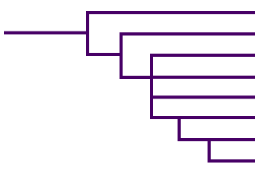
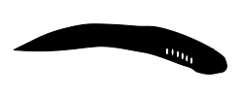

Hox Clusters & Evolution
How could changes to the Hox genes lead to macroevolution?
Evidence can be seen in the the chordate evolutionary tree and the expansion of Hox clusters in vertebrate evolution.
The common ancestor of all chordates had one cluster, as do living tunicates and cephalochordates (Amphioxus).
Cluster duplication has happened several times since along several phylogenetic lines.
Tunicates
Cephalochordates
One Hox cluster
Hagfish
Hox cluster duplication
Haikouichthys
(Cambrian vertebrate)
Hox cluster or genome duplications
Lamprey
Hox cluster duplication
Cartilaginous fish
Ray finned fishes
Jawed vertebrates

Slide 10
Shifting Hox Expression
Mice
Chick
Goose
Python
Neck length in vertebrates provides another example of how changes in gene expression can bring about changes in morphology.
Different vertebrates have different numbers of neck vertebrae.
The boundary between neck and trunk vertebrae is marked by expression of the Hoxc6 gene in all cases but…
the position varies in each animal relative to the overall body.
The forelimb (red arrow) arises at this boundary in all four-legged vertebrates.
In snakes, the boundary is shifted forward to the base of the skull and no limbs develop.
5
5
5
Hox c6
5
6
Hox c6
12
Hox c6
19
Hox c6
22
Hundreds of thoracic vertebrae
Mice have a short neck, geese long necks, and pythons virtually no neck at all (just a long trunk)
39
39

Slide 11
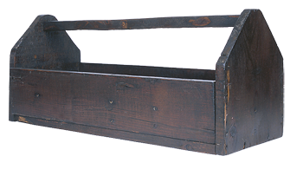
The Genetic Tool Kit
The Hox genes are just part of the collection of genes that make up the genetic tool kit for animal development.
The genes in the tool kit shape development by affecting how other genes are turned on or off in the course of development.
A large part of the tool kit comprises transcription factors; proteins that bind to DNA and act as genetic switches to turn gene transcription on or off.
Others are signalling proteins which bind to receptors and trigger a cascade of events, including:
changes in cell shape
migration
the beginning or end of cell multiplication
The genetic tool kit
Hox proteins |  | Master body-building genes |  | Cell type regulators
Other DNA binding proteins
Signalling proteins | Cellular receptors |  | Hormones |  | Coloration proteins

Slide 12
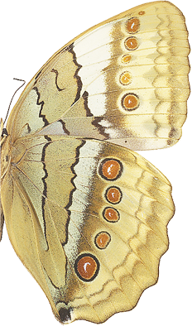
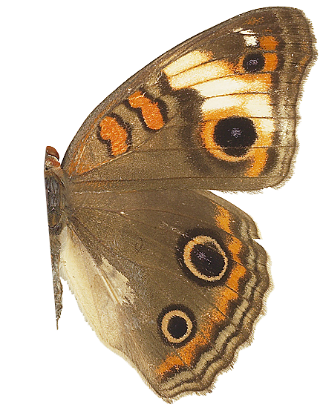
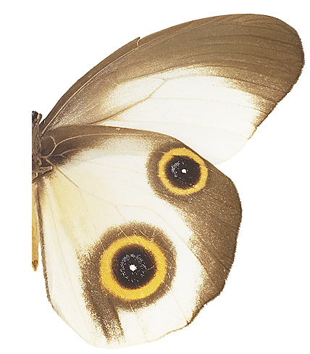
Genetic Switches
The distribution of genes in the tool kit tells us that it is ancient and was in place before the evolution of most types of animals.
Animals share a common tool kit, so how do differences in form arise?
Genetic switches (transcription factors) control zones of gene expression during development.
Changes in the DNA sequence of a switch can change the zone of gene expression without disrupting the function of the tool kit protein itself.
Stichophthalma camadeva
Junonia
coenia
Taenaris macrops
The wing spots in butterflies represent different degrees of a basic pattern: from virtually all eyespot elements expressed to very few.

Slide 13
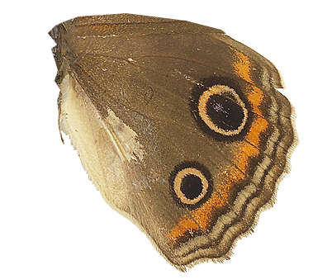
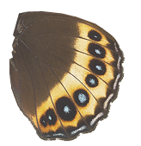
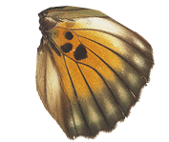
Same Gene-New Tricks
Example: Switches in the Distal-less gene control expression in the embryo, larval legs, and wing in flies and butterflies, but…
butterflies also evolved an extra switch to control expression in eyespots.
The action of a tool kit protein depends on context: where particular cells are located when it is switched on.
Once the Distal-less spots evolved, changes in Distal-less expression (through changes in the switch) produced more or fewer spots.
E
L
W
Three switches in a fly
gene
E
L
W
S
A new switch S evolved in butterflies
gene
embryo
leg
wing
eyespots
Changes in Distal-less regulation were probably achieved by changing specific sequences of the Distal-less gene eyespot switch.
Result: changes in eyespot size and number

Slide 14
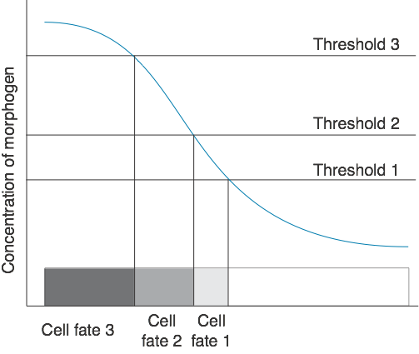
The Timing of Development
The differentiation of cells is controlled by cell signalling, either by producing a gradient of molecules through the embryo or by signalling a specific cell that then signals other cells in sequence.
Cell signals regulate transcription factors that in turn control the differential gene expression that shapes embryos.
This process, called embryonic induction, takes hours to days, while the time a cell can respond to an inducing signal is strictly limited.
Morphogens are signal molecules that govern patterns of tissue development. Morphogens induce cells in different positions to adopt different fates by diffusing from an area of production through a field of cells.

Slide 15
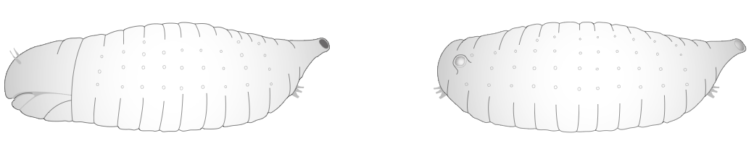
Development in Drosophila
The bicoid gene is important in Drosophila development.
After fertilisation, bicoid mRNA from the mother is passed to the egg where it is translated into bicoid protein.
Bicoid protein forms a concentration gradient in the developing embryo, which determine where the anterior and posterior develop.
Decreasing bicoid concentration
In a region of high bicoid concentration, the head and anterior structures develop.
In low bicoid concentration, the anus and posterior structures develop.
Normal embryo
If bicoid is absent from the egg, the embryo develops two posterior ends and no head. Development stops.

Slide 16
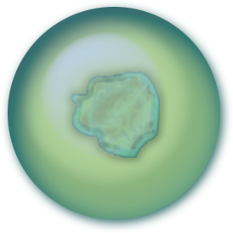
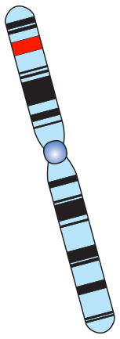
Mutations
Mutations are alterations in the DNA of chromosomes.
Many mutations may be neutral or 'silent' (i.e. they have no observable effect on the organism).
Harmful mutations become evident because they may alter the survival or reproduction of the organism (i.e. its fitness).
Mutations may cause an observable change in the organism’s:
Physiology
Anatomy
Behaviour
Mutations can alter the cell’s chemistry.
Cell
Mutation
Nucleus
Chromosome

Slide 17
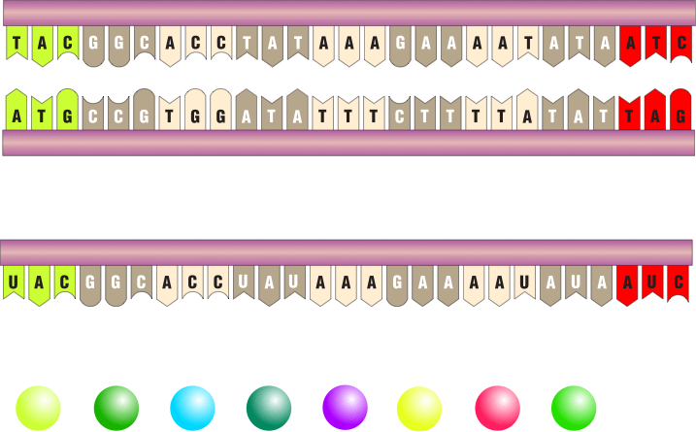
Mechanism of Mutation
Polypeptide chain
Mutations come in many forms.
Point mutations affect one base pair in the DNA. The base pair can be lost, duplicated, or substituted.
The loss or duplication of a base pair causes a reading frame shift as every triplet after the mutation is affected.
A substitution may change a single amino acid.
More extensive mutations may affect whole blocks of genes.
Triplet
Gene
Original sequence
Polypeptide chain
Triplet
Gene
The loss of one base can cause a shift in the reading frame and produce new amino acids in the protein.

Slide 18
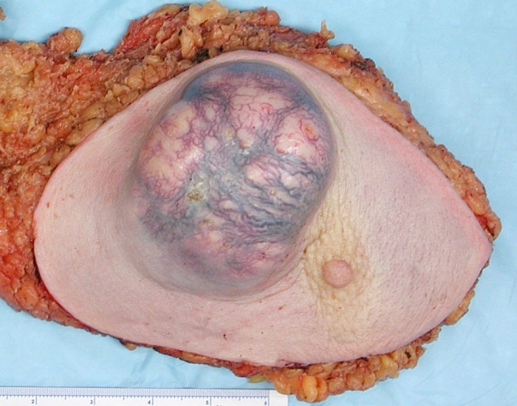
Causes of Mutations
Mutations may occur randomly and spontaneously.
They may also be induced by environmental factors.
Spontaneous mutations
Arise from errors in replication
Genes mutate at different rates
Induced mutations
Mutations can be induced by mutagens (environmental factors that cause a change in DNA).
Examples of mutagens:
Radiation (e.g. UV rays)
Viruses
Microorganisms
Environmental poisons and irritants
Alcohol and diet
Tumour
Normal tissue
Nipple
Emmanuelm cc3.0
Carcinogens are mutagens that cause cancer (malignant tumours) such as this breast tumour.

Slide 19
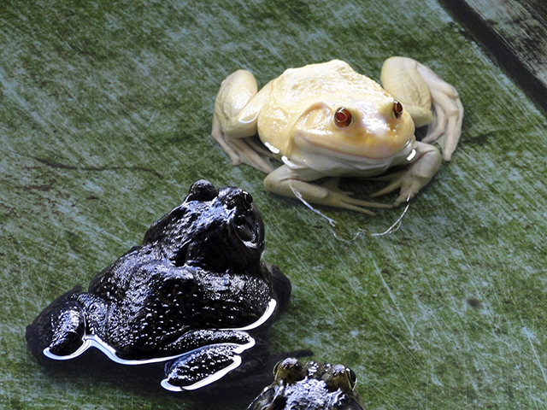
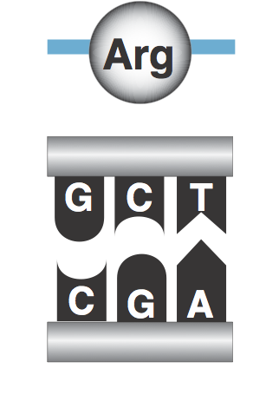
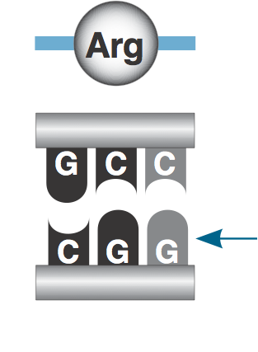
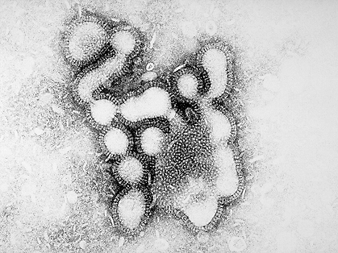
Mutations
Harmful Mutations:
Most mutations cause harmful effects, usually because they stop or alter the production of a protein (often an enzyme). Albinism (right) is one of the more common mutations in nature, and leaves an animal with no pigmentation.
Silent Mutations:
Silent mutations do not change the amino acid sequence nor the final protein. In the genetic code, several codons may code for the same amino acid. Silent mutations are also neutral if they do not alter the fitness of the organism.
Beneficial Mutations
Sometimes mutations help the survival of an organism. In viruses (e.g. Influenzavirus, right) genes coding for the glycoprotein coat are constantly mutating, producing new strains that avoid detection by the host's immune system.

Slide 20
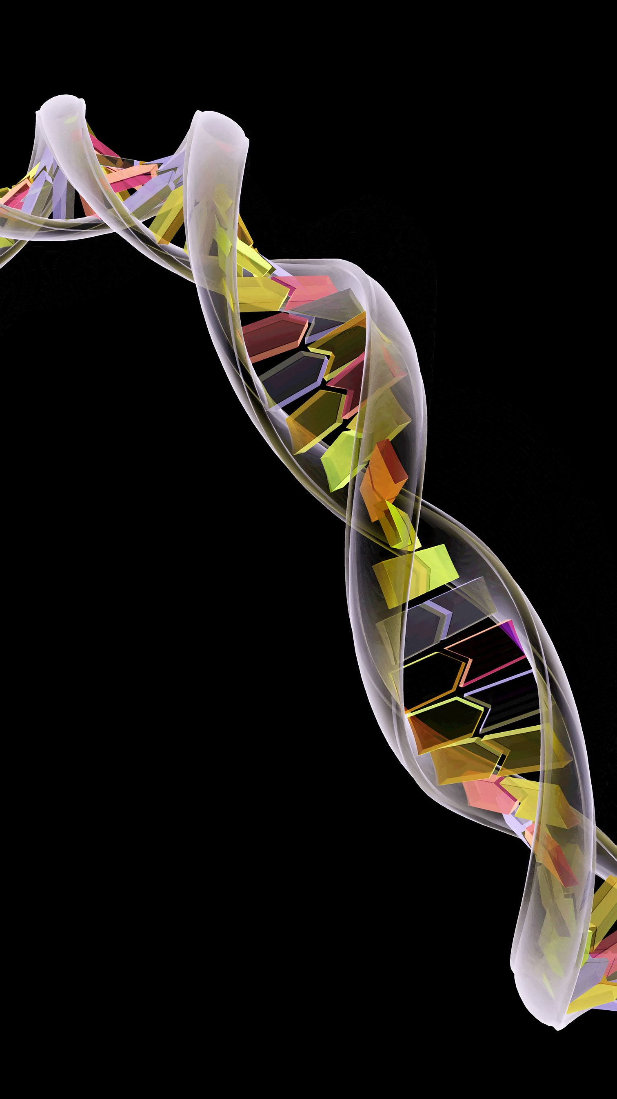
Controlling Gene Expression
All the cells in your body contain identical copies of your genetic instructions. Yet these cells appear very different (e.g. muscle, nerve, and epithelial cells have little in common).
These morphological differences reflect profound differences in the expression of genes during the cell’s development.
For example, muscle cells express the genes for the proteins that make up the contractile elements of the muscle fibre.
This diversity of cell structure and function reflects the precise control over the time, location, and extent of expression of a huge variety of genes.
Adobestock

Slide 21
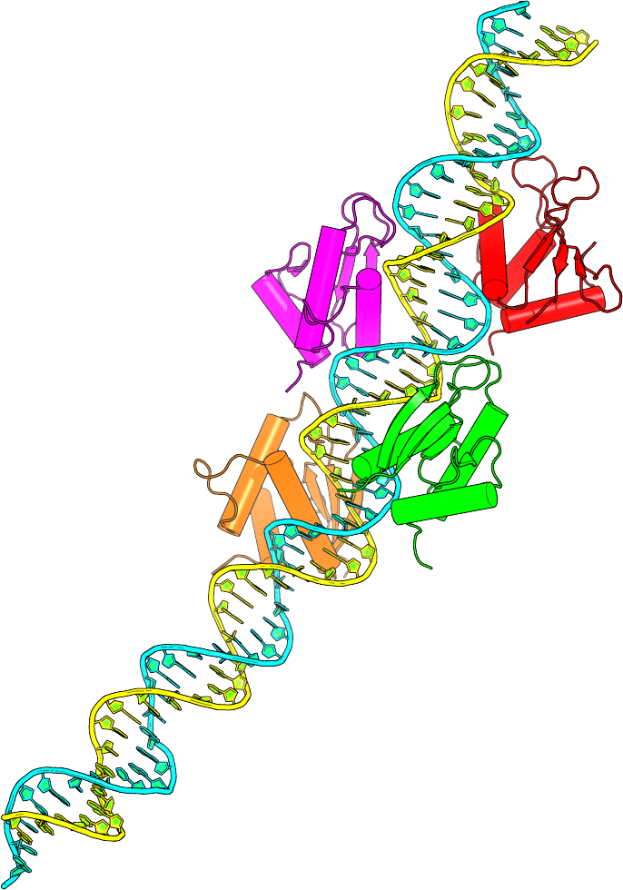
Transcription Factors
The physical state of the DNA in or near a gene is important in helping to control whether the gene is even available for transcription.
When the heterochromatin is condensed, the transcription proteins cannot reach the DNA and the gene is not expressed.
To be transcribed, a gene must first be unpacked from its condensed state.
Once unpacked, control of gene expression involves the interaction of transcription factors (shown attached to the DNA molecule right) with DNA sequences that control the specific gene.
Initiation of transcription is the most important and universally used control point in gene expression.
Transcription factors
DNA

Slide 22
Prokaryote Gene Structure
In prokaryotes, several structural genes with related functions are grouped together between UTRs.
These groupings of structural genes and their regulatory elements are called operons.
The UTR upstream of the structural genes contains a regulatory sequence to initiate transcription of the structural genes.
The downstream UTR stops transcription of the genes.
In prokaryotes, the entire transcribed mRNA sequence for the structural genes is translated into proteins.
Regulatory elements
Structural genes
Regulatory elements
DNA
UTR
Gene 1
Gene 2
Gene 3
UTR
mRNA
UTR
Gene 1
Gene 2
Gene 3
UTR
Protein 1
Protein 2
Protein 3

Slide 23
Gene Regulation in Prokaryotes
The lac operon (lactose operon) is an operon required for the transport and metabolism of lactose in many bacteria including Escherichia coli.
It is often used to study the control of gene expression in prokaryotes.
The operon model applies only to prokaryotes because eukaryotic genes are not found as operons.
Regulatory gene encodes repressor molecule
Regulatory untranslated region (UTR)
Structural genes: translated region
Regulator gene
Promoter
Operator
Structural gene 1
Structural gene 2
Structural gene 3
Operon
The operon consists of the structural genes and the promoter and operator sites
The regulator is some distance from the operon. It codes for the repressor that prevents the expression of specific genes.
The promoter site is where the RNA polymerase enzyme first attaches itself to the DNA to begin synthesis of the mRNA.
The operator is an “on-off” switch that controls RNA polymerase’s access to the structural genes. It is the repressor binding site.

Slide 24
Eukaryote Gene Structure
In eukaryotes, structural genes are also under the control of regulatory genes. However, only one structural gene is enclosed by UTRs and there is no 'bulk control' of a structural gene sequence as seen in prokaryotes.
It is important to remember that before the primary RNA transcript is translated in eukaryotes, the non-protein coding introns are removed (only the protein-coding exons form the mature mRNA for translation).
DNA
UTR
Exon
Intron
Exon
Intron
Exon
Intron
UTR
mRNA
UTR
Exon
UTR
Protein 1

Slide 25
Eukaryote Gene Structure and Regulation
A eukaryotic gene includes more than just the region of exonic DNA that is translated into protein.
It also contains introns, regulatory untranslated regions (UTRs), a promoter to which the RNA polymerase binds, and a terminator region that signals the stop point of transcription.
The control sequences ensure that transcription begins and ends at the correct points and that the necessary sequences are present to create the mature mRNA that can be exported from the nucleus.
The promoter region is the binding site for regulatory proteins called transcription factors.
A gene contains both translated and untranslated regions, including control sequences
Upstream control elements
CCAAT box
TATA box
Poly-A tail signal sequence within the 3′ UTR
Transcription start (+1) 25-35 base pairs downstream of the TATA box
5′
Enhancers
5′ UTR
Exon
Intron
Exon
Intron
3′ UTR
3′
DNA coding strand
Promoter region. RNA polymerase recognises and binds
Terminator sequence signals STOP transcription

Slide 26
5′ UTR
Exon
Intron
Exon
Intron
Exon
Intron
3′ UTR
Primary transcript
Introns are removed to create the final mRNA
5′ UTR
3′ UTR
—AAAAAAAA
5′ cap
Mature mRNA
Poly-A tail

Slide 27
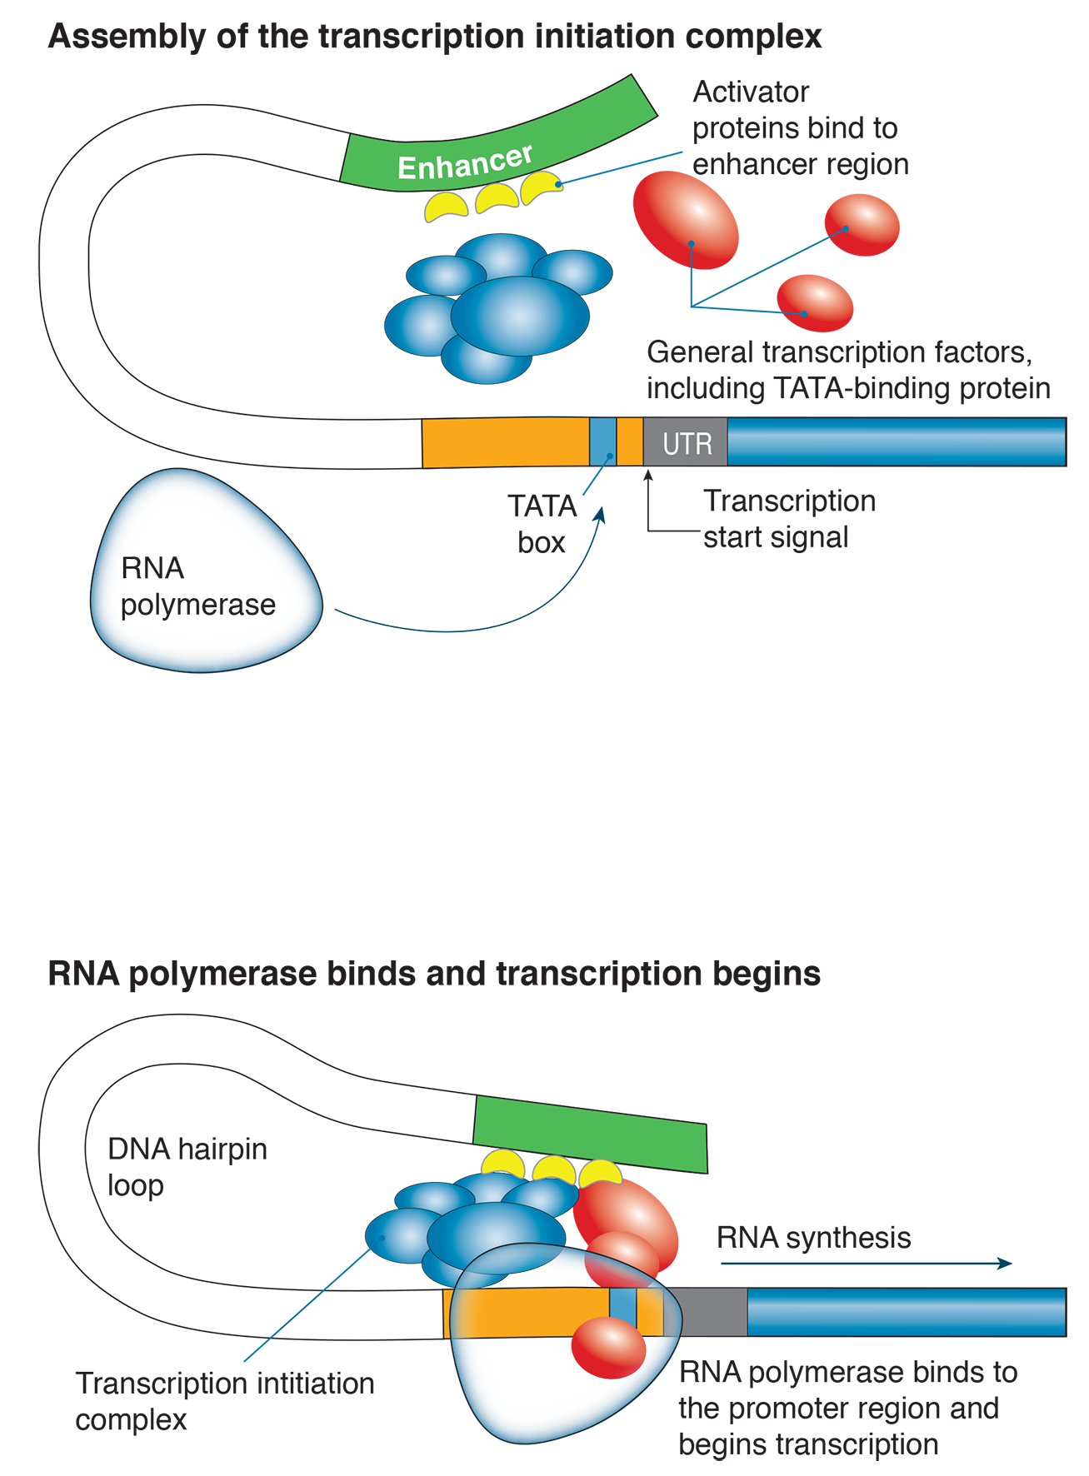
Transcription Mechanism
In eukaryotes, RNA polymerase requires the presence of transcription factors to initiate transcription.
Transcription factors are encoded by regulatory genes and have a role in creating an initiation complex for transcription.
Transcription factors bind to distinct regions of the DNA, including the promoter and upstream enhancers, and act as a guide to indicate to RNA polymerase where transcription should start.
The TATA binding protein is a subunit of a multiunit general transcription factor.
It is the first to bind to DNA, recruiting other transcription factors to form a transcription initiation complex.
Once bound to the promoter sequence, the transcription factors capture RNA polymerase, which can then begin transcription.

Slide 28
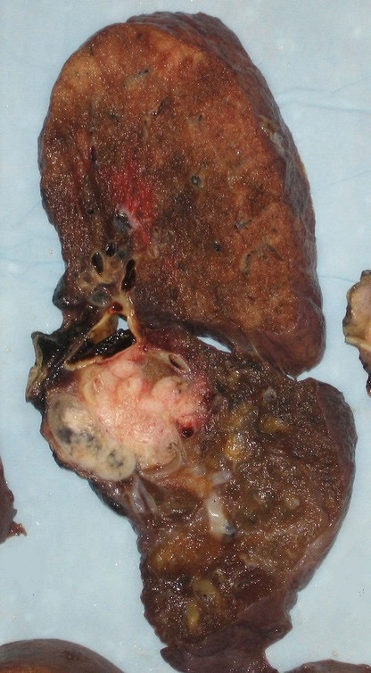
Gene Regulation and Cancer
Cells that become damaged beyond repair will normally undergo a programmed cell death (apoptosis), which is part of the cell's normal control system.
Cancer cells evade this control and become immortal, continuing to divide without any regulation.
Carcinogens are agents capable of causing cancer. Roughly 90% of carcinogens are also mutagens, i.e. they damage DNA.
Long-term exposure to carcinogens accelerates the rate at which dividing cells make errors.
Any one of a number of cancer-causing factors (including defective genes) may interact to induce cancer.
Lung tissue
Cancer
Emmanuelm cc3.0

Slide 29
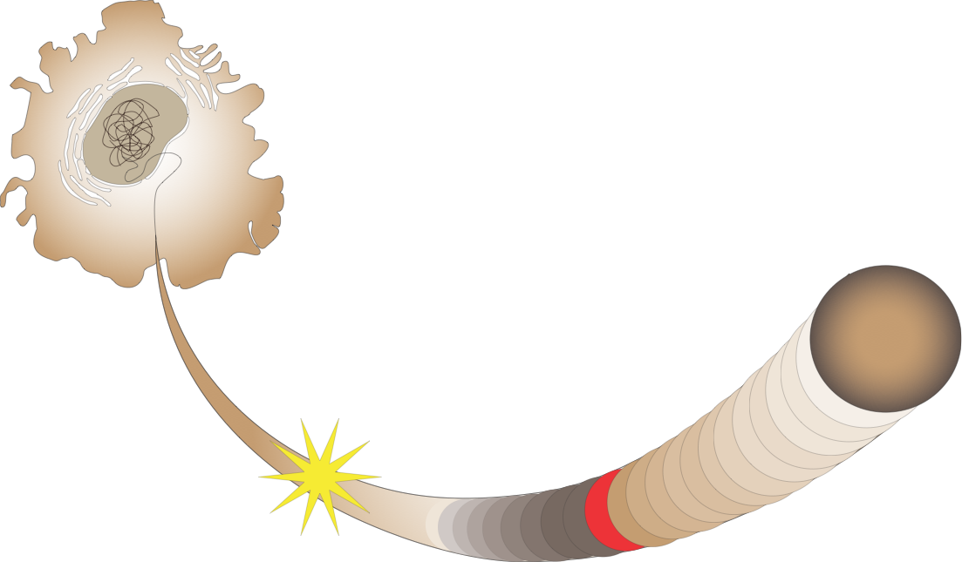
Cells out of Control
A mutation in one or two of the controlling genes causes a benign (nonmalignant) tumour.
As the number of controlling genes with mutations increases, so too does the loss of control until the cell becomes cancerous.
If the damage is too serious to repair, p53 activates other genes that cause the cell to self-destruct.
Tumour-suppressor genes
When damage occurs, the tumour-suppressor gene p53 commands other genes to bring cell division to a halt.
Damaged DNA
DNA molecule
Proto-oncogenes
Genes that turn on cell division. The mutated form or oncogene leads to unregulated cell division.
If repairs are made, then p53 allows the cell cycle to continue.

Slide 30
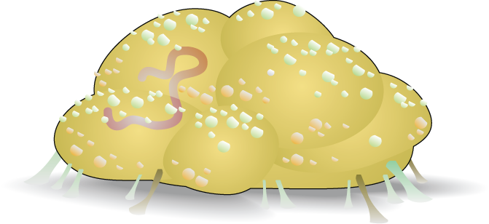
Features of a Cancer Cell
Cancer cells do not differentiate into a specialist cell type.
A cancer cell is analogous to a parasite, taking nutrients from surrounding cells by forming large numbers of blood vessels to supply it.
A cancer cell undergoes uncontrolled division, which is not inhibited by contact with surrounding cells.
Cancer cells can be motile, enabling them to spread (metastasize) around the body.
There may be an unusual number of chromosomes.
Cancer cells have a bloated, lumpy shape.
Cancer cells lose their attachment to neighbouring cells.

Slide 31
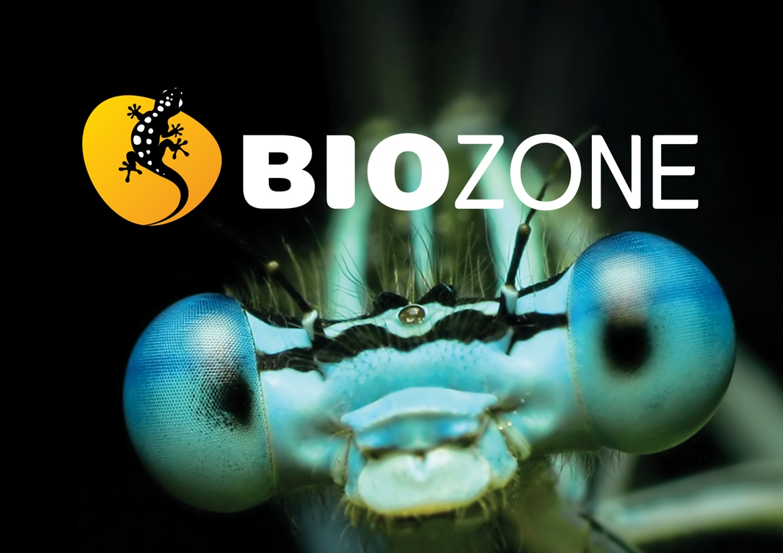

Slide 32
Conditions of Use
NOTE: Presentation Media = presentations available on CD-ROM/DVD-ROM or as downloads
BIOZONE retains copyright to the intellectual property included in the Presentation Media files, with acknowledgement that certain photos are used under license and are credited appropriately.
You MAY:
Use the Presentation Media files for presentations in your classrooms using a data projector, interactive whiteboard or overhead projector.
Place the Presentation Media files on any staff computer within the school, including staff laptops, but not in contradiction to clause (g).
Place the Presentation Media files on:
The school’s intranet (school computer network)
VLE (Virtual Learning Environment)
A CMS (Content Management System).
Student and staff access must be restricted to those who are enrolled/working on the campus of the registered purchaser. Student and staff access to a VLE or a CMS must be controlled by a user login and password protocol, but not in contradiction to clause (f). If students have access, they need to be made aware of the Conditions of Use and are only allowed to view the content.
Edit and customise the Presentation Media files by adding, deleting, and modifying information to better suit your needs, but not in contradiction to clauses 2 (c) - (d).
Print out the Presentation Media files in PowerPoint® or Keynote® “Handouts” mode for the express purpose of allowing students to make their own notes about the presentation, but not in contradiction to clause (e).
You MAY NOT:
Place the Presentation Media files on to the Internet or on a service that may be accessed off-campus unless access to the service is protected by a user login and password protocol, and is restricted to students and staff enrolled/working on the campus of the registered purchaser.
Place the Presentation Media files on student laptop computers.
REMOVE any of the references to BIOZONE, the title slides, copyright notices, photo credits, or Conditions of Use from the Presentation Media files.
Create a NEW document using any of the graphics/images in the Presentation Media files.
Print the Presentation Media files on to paper to make your own worksheets for distribution to students.
Incorporate any part of the Presentation Media files for the production of another commercial product.
Share or give away any content off-campus. This prohibition apples to, but is not limited to, sharing via the Internet or any website, (examples: YouTube, slide sharing websites).
Conditions of Use are subject to change without notice. Visit http://www.biozone.com.au/faqconditionsofuse/

Slide 33
Photo Credits
Photographic images are used under license from the following commercial photo libraries:
Corel Corporation Professional Photos (uncoded)
ArtToday.com (coded AT)
Clipart.com (coded CA)
PhotoObjects.com (coded PO)
iStock.com (coded iStock)
Hemera Technologies Inc. (coded Hemera)
Photos.com (coded PC)
Education interactive (coded EII)
Digital Stock (coded DS)
LifeArt (coded LA)
Dollar Photo Club (coded DPC)
Adobestock
3D models were created using Poser
Additional artwork and photographs are the property of BIOZONE International Ltd. All rights reserved.
Some 2D artwork has been adapted from TechPool STUDIOS LifeArt Collections, used under licence.
Images from the Public Domain: Where these licenses have been used, authors and licenses have been acknowledged alongside their image.
Centers for Disease Control (coded CDC)
National Institutes of Health (coded NIH)
National Aeronautics and Space Administration (NASA)
Images from the public domain include limited copyright, copyright expired, uncopyrighted, or uncopyrightable material:
Licenses including: GNU Free Documentation License http://www.gnu.org/copyleft/fdl.html
Creative Commons Attribution Share Alike http://creativecommons.org/licenses/by-sa/3.0/
Wikimedia Commons
NOTE: Where images are edited or moved from or within this file, the accompanying photo credit must be retained.

Slide 34
